Slide 1
VDS STRESS TEST
FBG10N30

Slide 2
DC STRESS
Parts were grouped and run at successively higher voltage.
  Test period was ~18 hours (Overnight)
  Parts tested with full parametric test on Focused tester after every step.
  VDS tested : 80V to 170V at Temperatures of 110C, 130C, 150C,170C
  Parts with very high leakage were removed at each step
  X axis (voltage represents Applied stress voltage not test voltage)

Slide 3
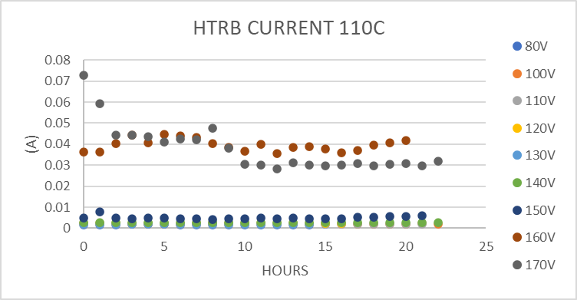
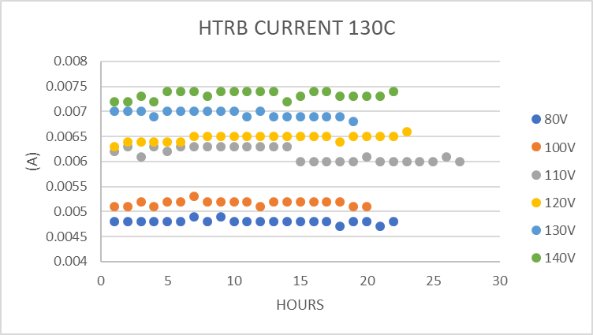
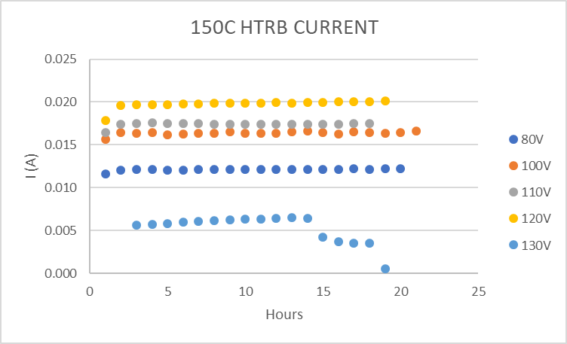
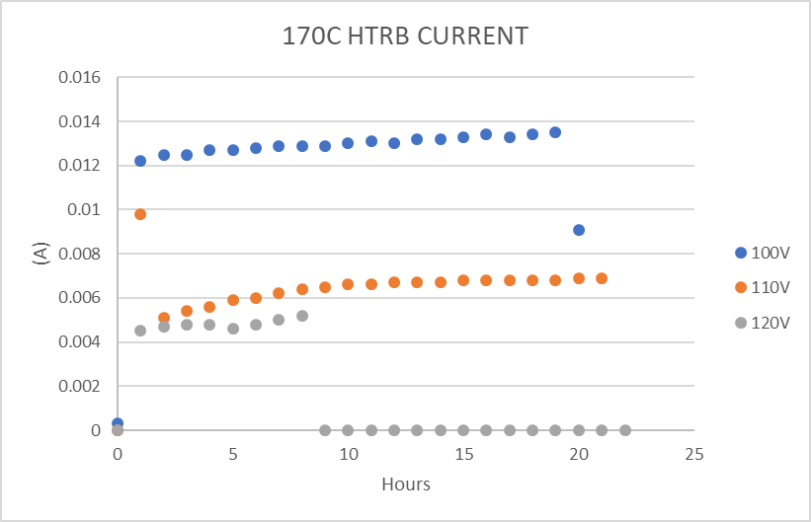
HTRB OVEN LOGS

Slide 4
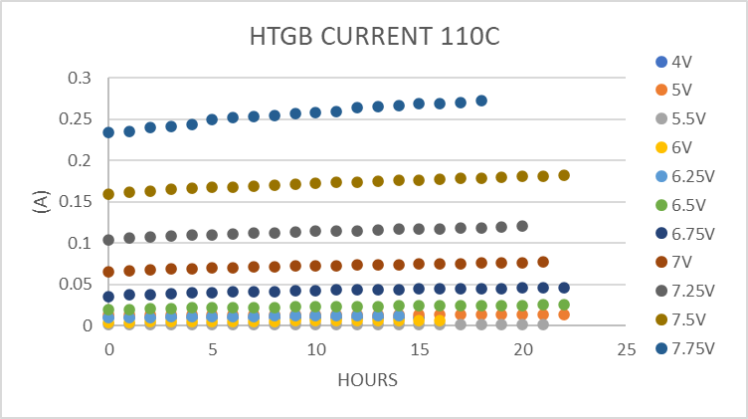
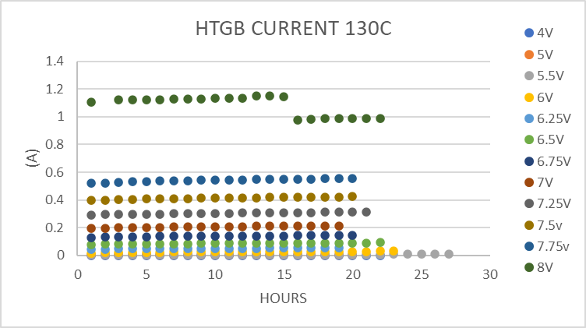
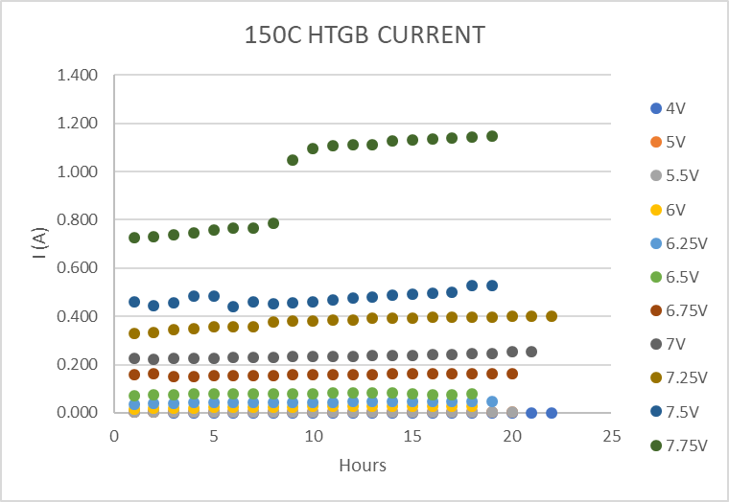
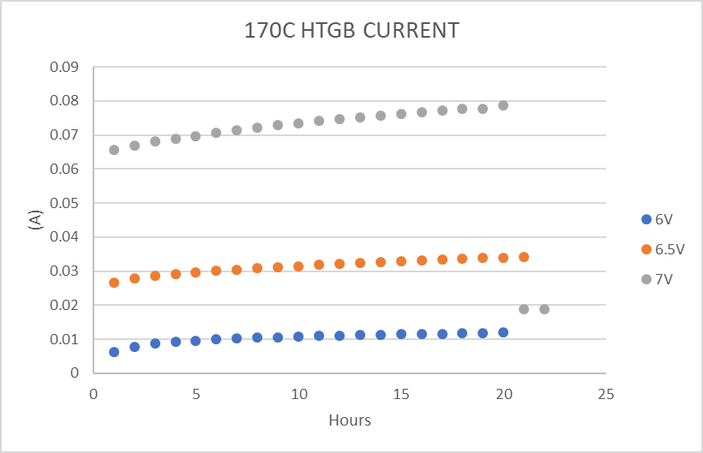
HTGB OVEN LOGS

Slide 5
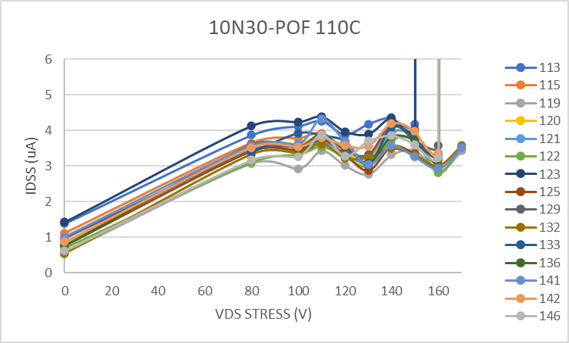
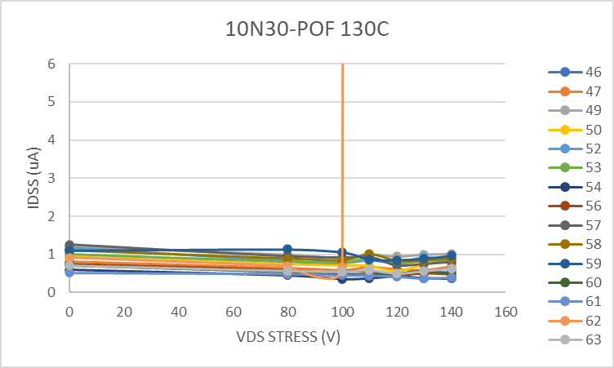
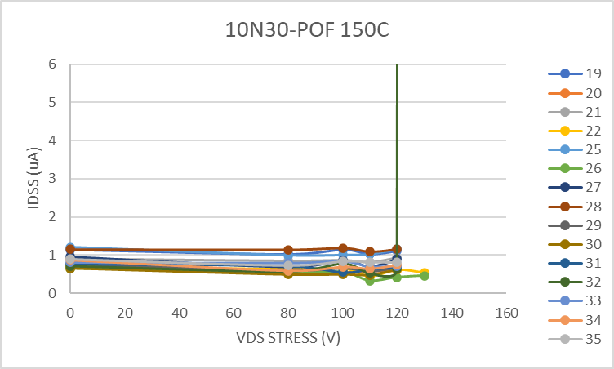
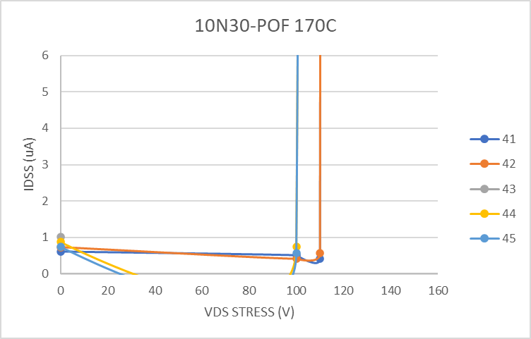
IDSS - HTRB
IDSS measured at 100V

Slide 6
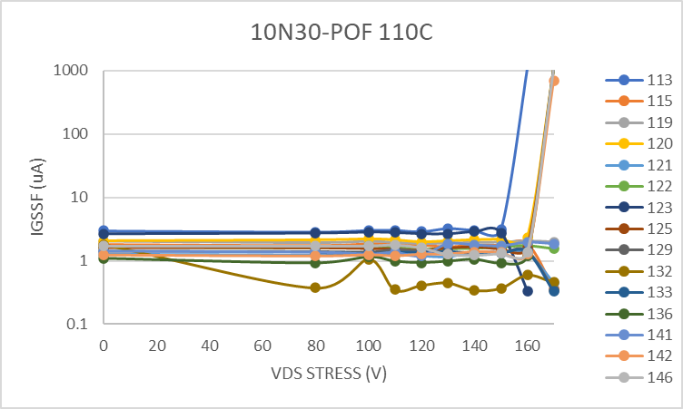
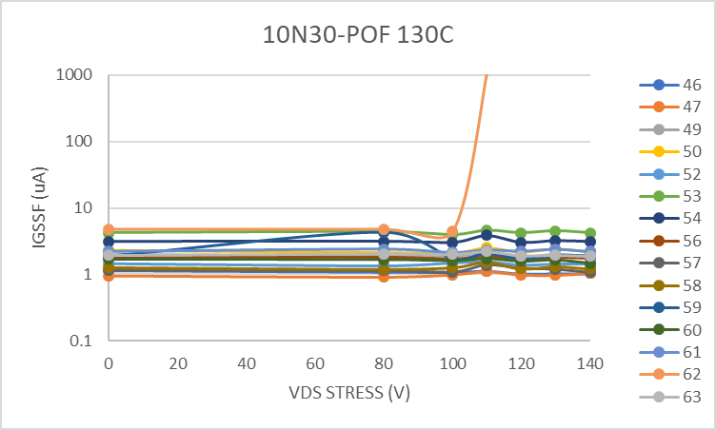
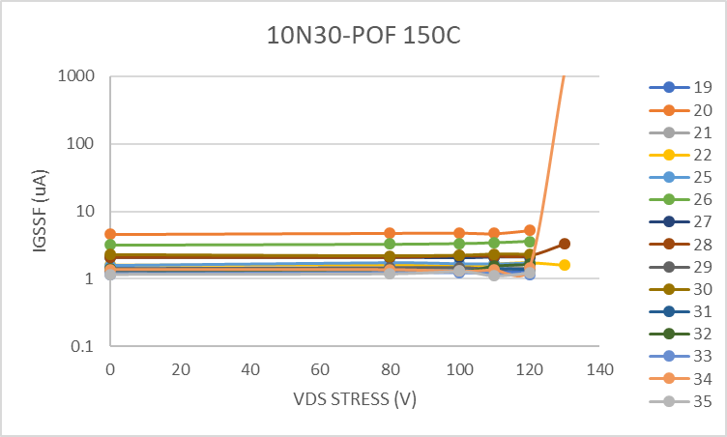
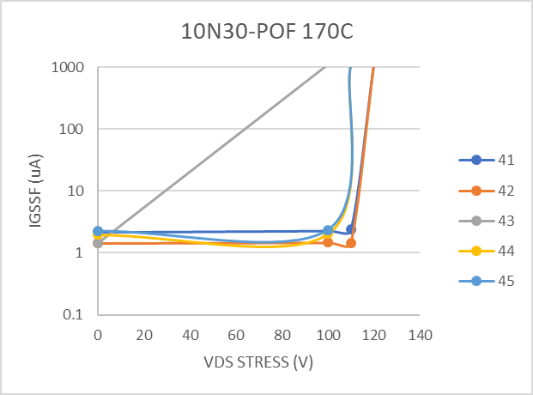
IGSSF - HTRB
IGSS measured at 5V

Slide 7
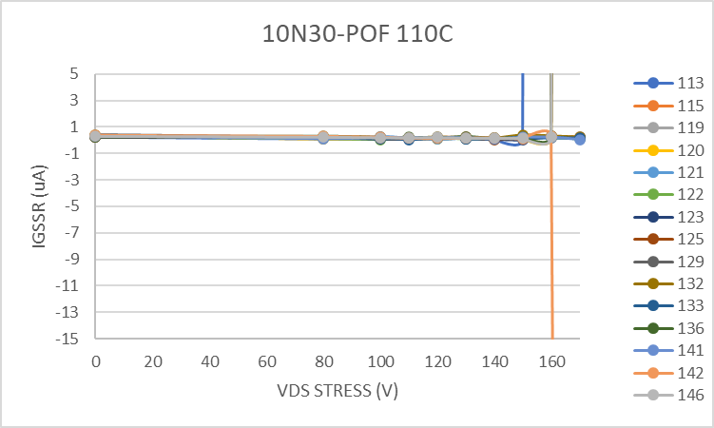
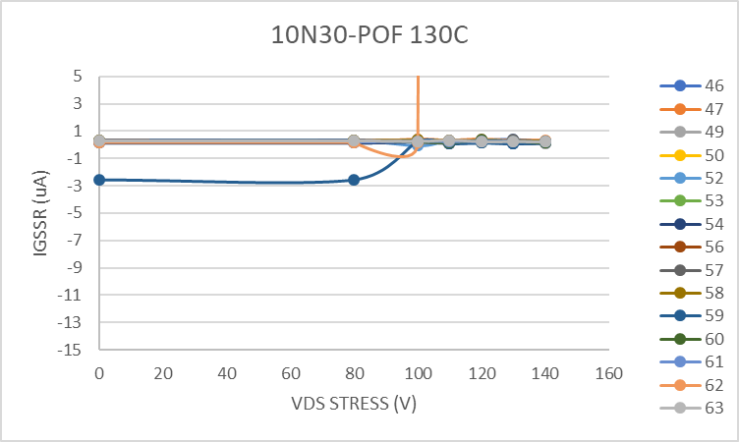
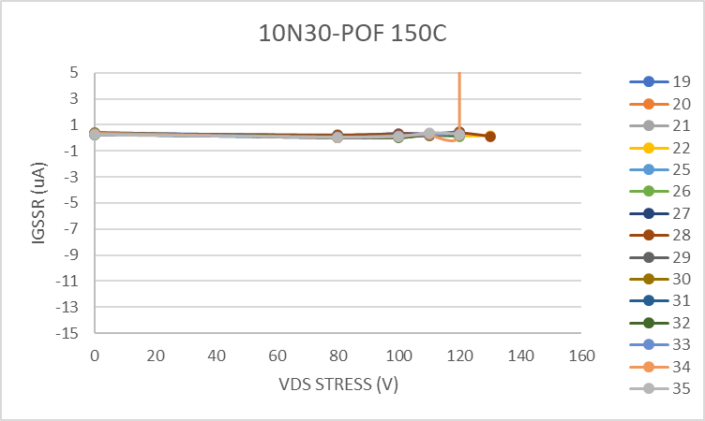
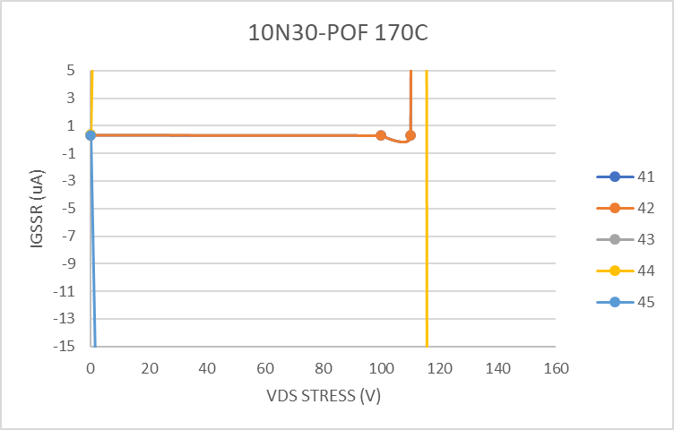
IGSSR - HTRB
IGSR measured at -4V

Slide 8
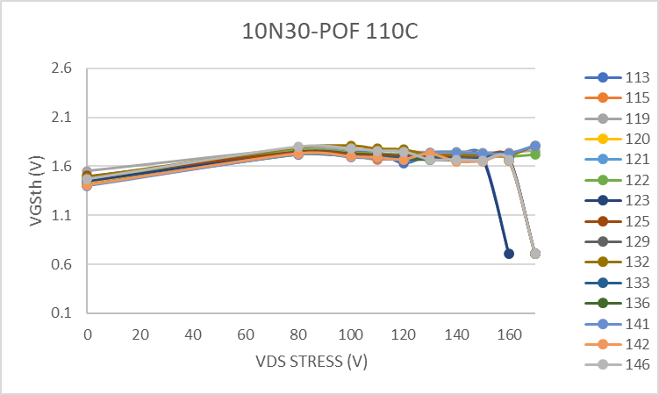
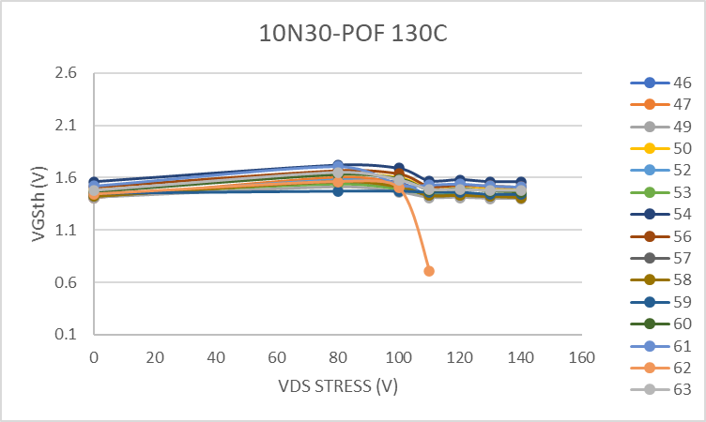
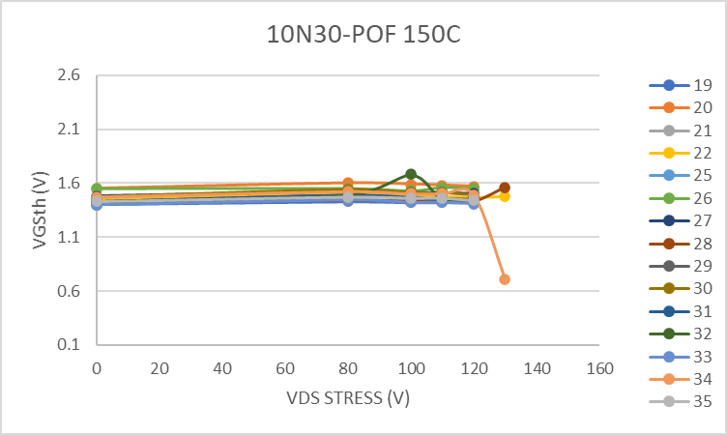
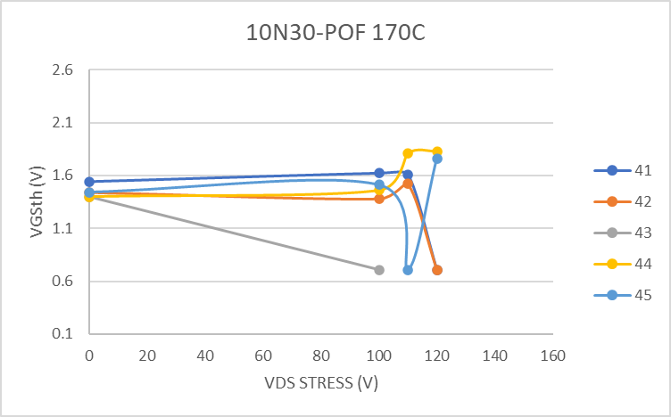
VGSth - HTRB
VGS th measured at 5mA

Slide 9
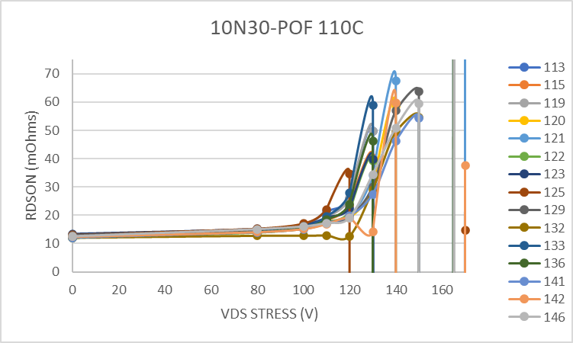
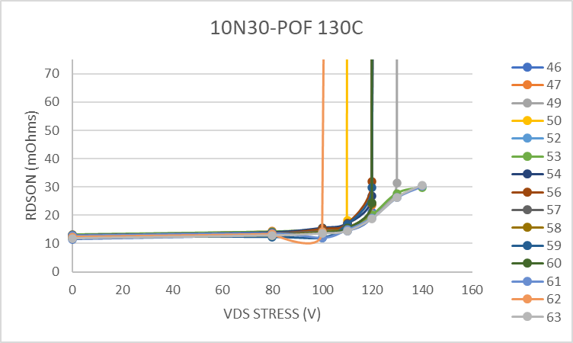
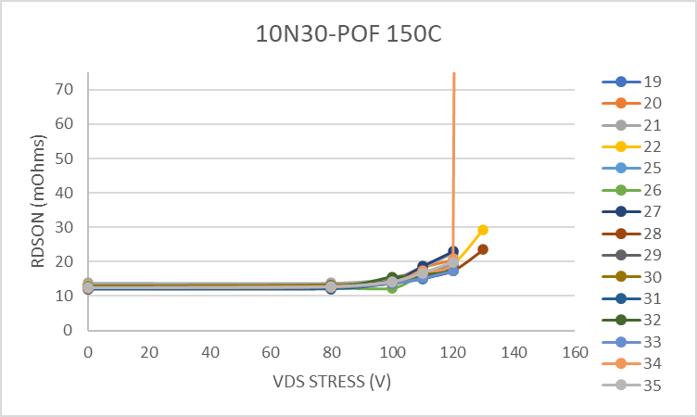
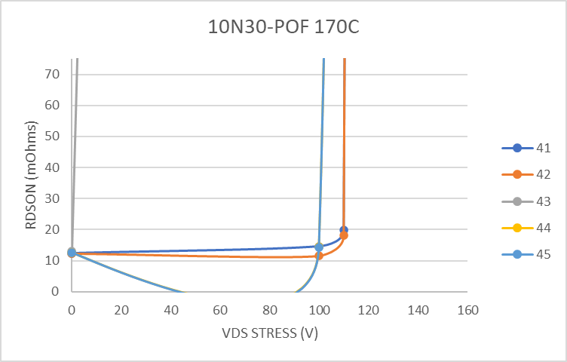
RDSON - HTRB
RDSON measured at 30A, Vgs 5V

Slide 10
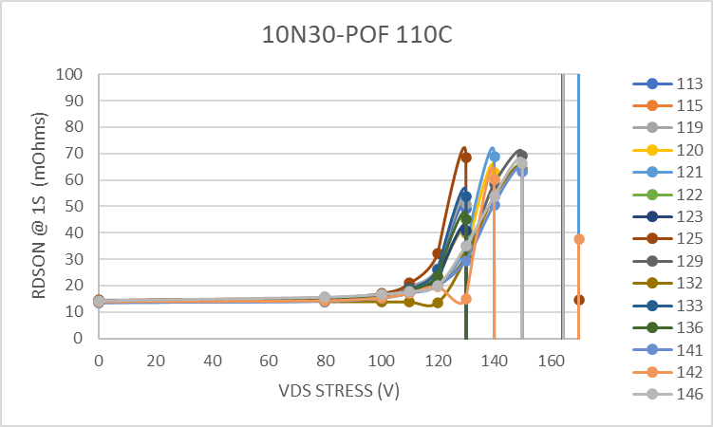
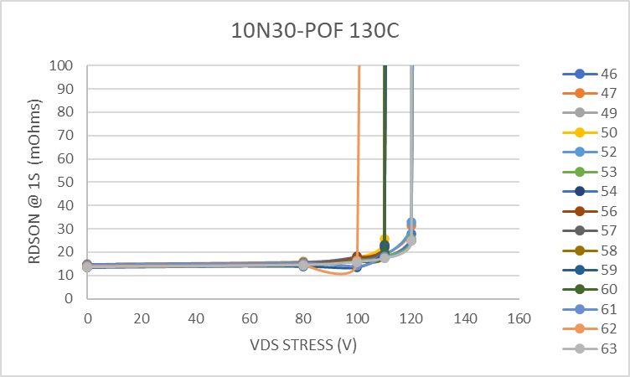
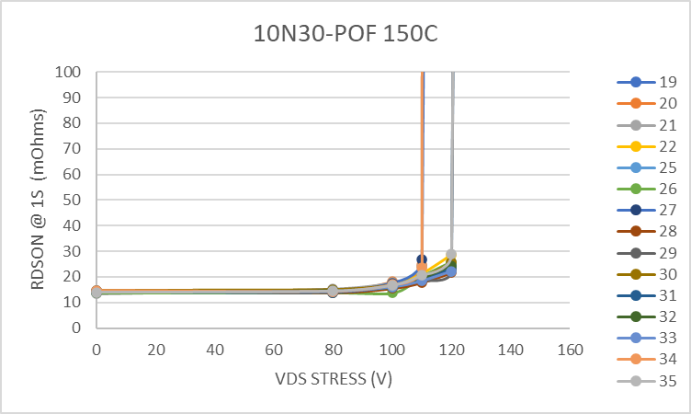
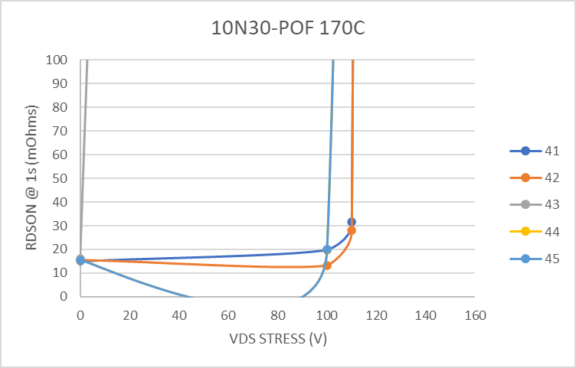
RDSON 1s - HTRB
RDSON measured at 30A, Vgs 5V

Slide 11
OVEN LOG SUMMARY
 | HTRB Voltage | Current (mA) | # Parts | Avg Power per part | Notes | HTGB Voltage | Current (mA) | # Parts | Avg Power per part | Notes
110C |  |  |  |  |  | 4 | 1 | 15 | 0.000
 | 80 | 1.8 | 15 | 0.010 |  | 5 | 1.4 | 15 | 0.000
 | 100 | 2.2 | 15 | 0.015 |  | 5.5 | 1.5 | 15 | 0.001
 | 110 | 2.1 | 15 | 0.015 |  | 6 | 5.5 | 15 | 0.002
 | 120 | 2.2 | 15 | 0.018 |  | 6.25 | 11 | 15 | 0.005
 | 130 | 1.9 | 15 | 0.016 |  | 6.5 | 22 | 15 | 0.010
 | 140 | 2.8 | 15 | 0.026 |  | 6.75 | 43 | 15 | 0.019
 | 150 | 4.8 | 15 | 0.048 |  | 7 | 72 | 15 | 0.034
 | 160 | 5 | 15 | 0.053 | 2 parts fail | 7.25 | 115 | 15 | 0.056
 | 170 | 4.2 | 13 | 0.055 | 9 parts fail | 7.5 | 174 | 15 | 0.087
 |  |  |  |  |  | 7.75 | 256 | 15 | 0.132 | 3 parts failed, many show signs of damage.
130C | 80 | 4.8 | 15 | 0.026 |  | 4 | 0.6 | 15 | 0.000
 | 100 | 5.3 | 15 | 0.035 |  | 5 | 1.6 | 15 | 0.001
 | 110 | 6.3 | 15 | 0.046 |  | 5.5 | 6 | 15 | 0.002
 | 120 | 6.5 | 14 | 0.056 | 1 Part blew fuse during run | 6 | 26 | 15 | 0.010
 | 130 | 7 | 14 | 0.065 | Parts failing Rdosn | 6.25 | 50 | 15 | 0.021
 | 140 | 7.4 | 14 | 0.074 | Many Parts failign Rdson | 6.5 | 87 | 15 | 0.038
 |  |  |  |  |  | 6.75 | 138 | 15 | 0.062
 |  |  |  |  |  | 7 | 205 | 15 | 0.096
 |  |  |  |  |  | 7.25 | 303 | 15 | 0.146
 |  |  |  |  |  | 7.5 | 411 | 15 | 0.206
 |  |  |  |  |  | 7.75 | 544 | 15 | 0.281 | 2 part failed
 |  |  |  |  |  | 8 | 1130 | 14 | 0.646 | 3 parts failed

Slide 12
OVEN LOG SUMMARY
 | HTRB Voltage | Current (mA) | # Parts | Avg Power per part | Notes | HTGB Voltage | Current (mA) | # Parts | Avg Power per part | Notes
150C | 80 | 12 | 15 | 0.064 |  | 4 | 1.6 | 15 | 0.000
 | 100 | 16 | 15 | 0.107 |  | 5 | 2.6 | 15 | 0.001
 | 110 | 17 | 15 | 0.125 |  | 5.5 | 4.1 | 15 | 0.002
 | 120 | 20 | 15 | 0.160 |  | 6 | 25 | 15 | 0.010
 | 130 |  |  |  | Lost Several parts at beginnig of run and more failed during run | 6.25 | 45 | 15 | 0.019
 |  |  |  |  |  | 6.5 | 80 | 15 | 0.035
 |  |  |  |  |  | 6.75 | 150 | 15 | 0.068
 |  |  |  |  |  | 7 | 233 | 15 | 0.109
 |  |  |  |  |  | 7.25 | 390 | 15 | 0.189
 |  |  |  |  |  | 7.5 | 460 | 15 | 0.230
 |  |  |  |  |  | 7.75 | 760 | 15 | 0.393 | 1 Part shorting during Run driving current over 1A
170C | 100 | 13 | 4 | 0.325 | 1 part blew fuse during the run | 6 | 10 | 5 | 0.012
 | 110 | 7 | 2 | 0.385 | 2 parts blew fuse at beginnig of the run | 6.5 | 31 | 5 | 0.040
 | 120 |  | 2 |  | 2 Parts blew fuse during run | 7 | 75 | 5 | 0.105

Slide 13
STRESS FAILURE SUMMARY
10N30 - STRESS Sumary
Temp | SN | Stress V | Notes | Action | Notes / Final Screening Value
110C | 113 | 160 | Blew Fuse
 | 123 | 160 | Blew Fuse
 | 125 | 120 | RDSON over 30 Mohms
 | Many | 130 | RDSON over 30 Mohms
 | ALL | 140 | RDSON over 30 Mohms
 | 143 | 7.75 | Vgsth Low
 | 145 | 7.75 | Vgsth Low
 | 91 | 7.75 | High Gate Leakage
 | 95 | 7.75 | High Gate Leakage
130C | 62 | 110 | Low Vgsth high IDSS | to FA | IGSS@5V - 11.8uA – 25C
 | Many | 130 | RDSON over 30 Mohms
 | ALL | 140 | RDSON over 30 Mohms
 | 50 | 120 | RDSON over 30 Mohms
 | 76 | 6.25 | high IDSS - below limt | to FA | IDSS @ 100V – 1.2uA – 25C
 | 68 | 7.75 | Vgsth Low
 | 65 | 8 | Vgsth Low
 | 80 | 8 | Vgsth Low
 | 72 | 8 | Vgsth Low
 | Many | 8 | High Gate Leakage

Slide 14
STRESS FAILURE SUMMARY
10N30 - STRESS Sumary
Temp | SN | Stress V | Notes | Action | Notes / Final Screening Value
150C | MANY | 130 | Blew Fuse |  | Except 22,28,34
 | 34 | 130 | Vgsth Low
 | 9 | 7.5 | Very High IGSSF and IGSSR
 | 16 | 7.5 | Very High IGSSF and IGSSR
 | 4 | 7.75 | Very High IGSSF and IGSSR
 | 18 | 7.75 | Very High IGSSF and IGSSR
 | 3 | 7.75 | Low Vgsth high IDSS
 | 7 | 6 | high IDSS - below limt | to FA | IDSS @ 100V– 1.8uA @25C
170C | 43 | 100 | Vgsth Low
 | 44 | 110 | Very High IGSSF and IGSSR
 | 45 | 110 | Very High IGSSF and IGSSR
 | 41 | 120 | Very High IGSSF and IGSSR
 | 42 | 120 | Very High IGSSF and IGSSR

